Slide 1

The Battle of the Neighborhoods
Xiaomeng shang
November 2020

Slide 2


Introduction
Stakeholders intend to open a Chinese restaurant in downtown Toronto, the main central business district of Toronto.
To analysis location information of the restaurants in downtown Toronto and to find an optimal location for stakeholders’ new restaurant.

Slide 3
Data
Postal code, Borough, Neighborhood name
https://en.wikipedia.org/wiki/List_of_postal_codes_of_Canada:_M
Geographical information
http://cocl.us/Geospatial_data
Venue Information
Foursquare API

Slide 4
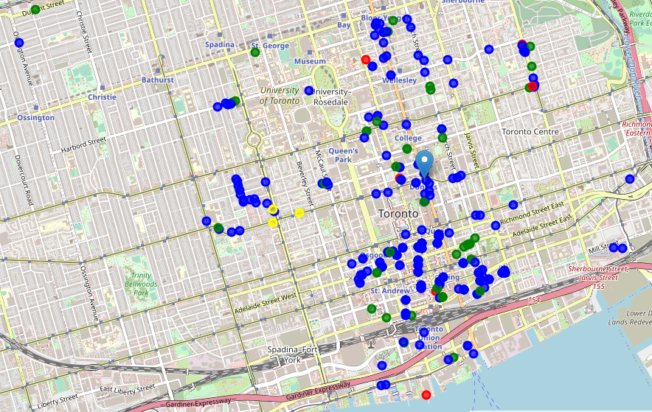
Overview
Chinese restaurant
Japanese restaurant or Italian restaurant
Dumpling Restaurant or Dim Sum Restaurant
Six Chinese restaurants

Slide 5
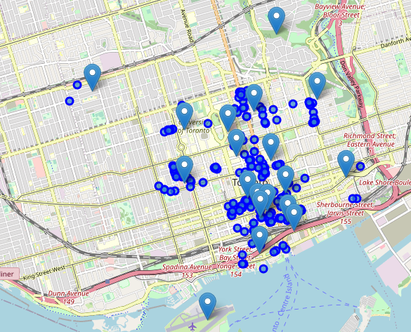
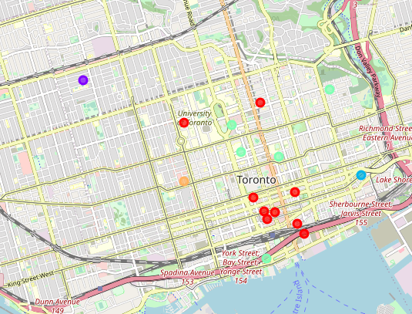
Analysis
Apply K-means algorithm to segment all neighborhoods and ger 5 clusters

Slide 6
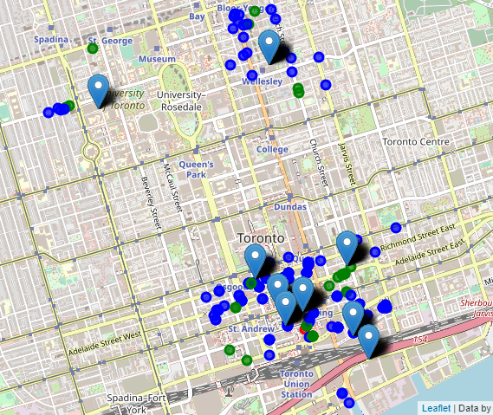
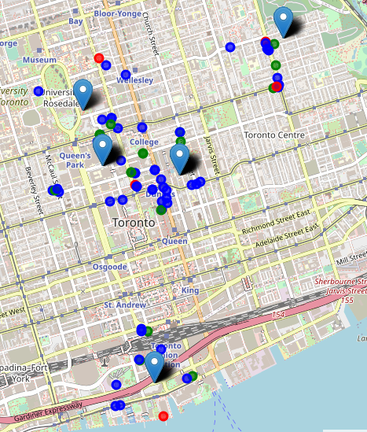
Result and Discussion
Cluster 1
One Chinese restaurant
Cluster 4
Five Chinese restaurants

Slide 7
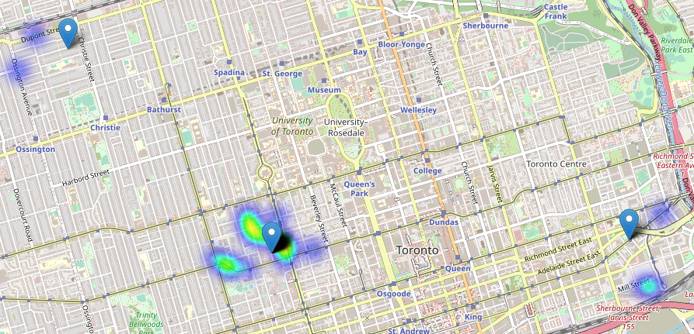
Result and Discussion
The restaurants intensity of neighborhoods ‘Kensington Market, Chinatown, Grange Park’ is in a middle level.
Cluster 2,3 and 5, where there is no Chinese restaurants

Slide 8
Conclusion
Our stakeholders intend to open their first Chinese restaurant in Toronto and they chose the downtown Toronto, the main central business district of Toronto.
It is not easy to entry a new market, that’s why they interest in area with no Chinese restaurants and area where restaurants are not crowded.
Based on the above analysis, we will recommend neighborhoods ‘Kensington Market, Chinatown, Grange Park’ for stakeholders.

